Slide 1
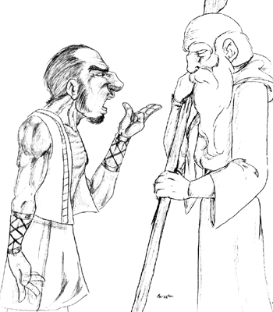
God’s Authority Challenged Established

Slide 2
Rebellion Against Moses
Three Part Contest
Challenge One, Korah: Numbers 16:1-3
Ye take too much upon you, seeing all the congregation are holy, every one of them, and the LORD is among them: wherefore then lift ye up yourselves above the congregation of the LORD?
Answer One: Numbers 16:4-11
This do; Take you censers, Korah, and all his company; And put fire therein, and put incense in them before the LORD to morrow: and it shall be that the man whom the LORD doth choose, he shall be holy: ye take too much upon you, ye sons of Levi. (Numbers 16:6-7)

Slide 3
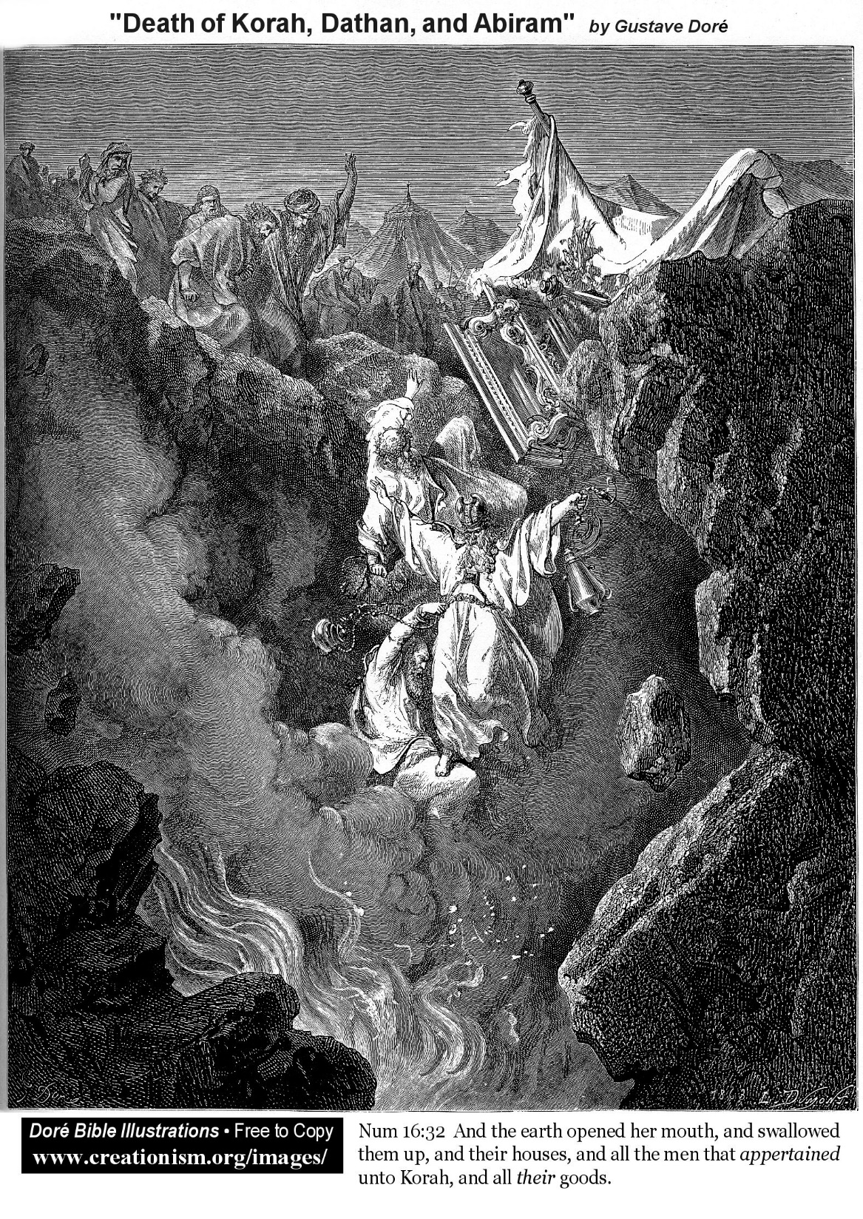
Rebellion Against Moses
Three Part Contest
Challenge Two: Numbers 16:12-14
And Moses sent to call Dathan and Abiram, the sons of Eliab: which said, We will not come up:
Answer Two: Numbers 16:15-40
But if the LORD make a new thing, and the earth open her mouth, and swallow them up, with all that appertain unto them, and they go down quick into the pit; then ye shall understand that these men have provoked the LORD.

Slide 4
Rebellion Against Moses
Three Part Contest
Challenge Three: Numbers 16:41
But on the morrow all the congregation of the children of Israel murmured against Moses and against Aaron, saying, Ye have killed the people of the LORD.
Answer Three: Numbers 16:42-50
And Aaron took as Moses commanded, and ran into the midst of the congregation; and, behold, the plague was begun among the people: and he put on incense, and made an atonement for the people. (47)

Slide 5
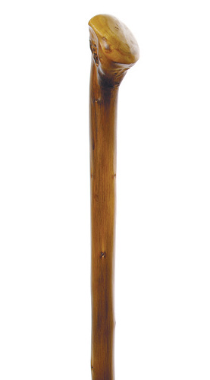
Rebellion Against Moses
Three Part Contest
Settling the Matter: Numbers 17:1-12
And it shall come to pass, that the man's rod, whom I shall choose, shall blossom: and I will make to cease from me the murmurings of the children of Israel, whereby they murmur against you. (Numbers 17:5)

Slide 6
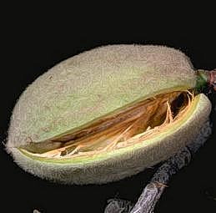
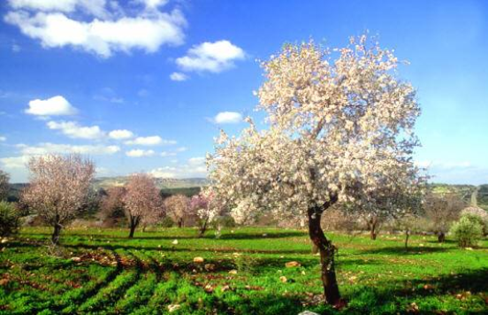
Rebellion Against Moses
Three Part Contest
Settling the Matter: Numbers 17:1-12

Slide 7
Rebellion Against Moses
Challenge |  | Response
1 | Moses: You Take Too Much Upon Yourself | Assemble!
2 | Moses: You Take Too Much Upon Yourself | Earth Opens, Fire
3 | Moses: You Killed the Lord’s Faithful | Plague Kills
Last |  | Budding Rod
Notes:
Budding rod one of three items stored in the ark of the covenant. Manna, Tablets, also.

Slide 8
David’s Desire to Build a Temple

Slide 9
David’s Desire to Build a Temple
2 Samuel 7
David’s Desire (1-2)
Nathan’s Reply (3)
God’s Reply (5-16)
Notes:
Compare David to Israelites in Haggai’s day (1:4). David had a good idea. And he checked with the religious leaders of the day. What could be wrong with that.

Slide 10
David’s Desire to Build a Temple
Tabernacle Is Working Fine (6)
Did I Tell You to Do That? (7)
Do You Need to Take Care of Me? (8-9)
When I Want a Temple I’ll Let You Know (10-11)
Your Descendant Will Build My House (12-13)
Your Kingdom Shall Endure Forever (14-16)
2 Samuel 7
David’s Desire (1-2)
Nathan’s Reply (3)
God’s Reply (5-16)

Slide 11
David’s Desire to Build a Temple
Most denominational errors originated the same way as David’s error.
Good people,
Good motives,
Good ideas,
Checked with peers.
Poor hermeneutic and poor concept of authority.

Slide 12
Remember God’s Idea of Authority
Old Methods Work Fine
Did I Tell You to Do That?
Do You Need to Take Care of Me?
When I Want Something New I’ll Let You Know

Slide 13
God’s Authority Challenged Established

