Slide 1
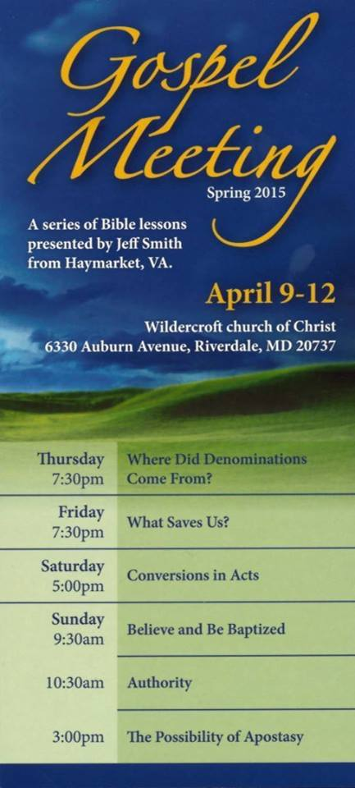

Slide 2
Believe and Be Baptized

Slide 3
And He said to them, "Go into all the world and preach the gospel to all creation. "He who has believed and has been baptized shall be saved; but he who has disbelieved shall be condemned.
(Mark 16:15-16)
Notes:
Criticism of Mark 16:9-20. Not all of the earliest MSS contain this. Survey of Bible Versions represented.

Slide 4
Believe + Be Baptized = Saved
And He said to them, "Go into all the world and preach the gospel to all creation. "He who has believed and has been baptized shall be saved; but he who has disbelieved shall be condemned.
(Mark 16:15-16)
Notes:
Use ampersand to indicate that the operation is not commutative as addition is.

Slide 5
Believe & Be Baptized = Saved
Notes:
Use ampersand to indicate that the operation is not commutative as addition is.

Slide 6
Believe & Be Baptized = Saved
Not Everyone Accepts This.
Notes:
Use ampersand to indicate that the operation is not commutative as addition is.

Slide 7
Believe & Be Baptized ≠ Saved
Who Believes This?
Notes:
World Religions: Hindus, Muslims, Daoists, Buddhists, Atheists,

Slide 8
Don’t Believe & Don’t Be Baptized = Saved
Who Believes This?
Notes:
Universalists. Rastafarian Universalist.

Slide 9
Believe = Saved
Who Believes This?
Notes:
Baptists. Roman Catholics, Episcopalians.

Slide 10
Be Baptized = Saved & Believe
Who Believes This?
Notes:
Roman Catholics and all who baptize infants

Slide 11
Believe & Be Baptized = Saved
This Is What God Said. Trust This.
Notes:
Use ampersand to indicate that the operation is not commutative as addition is.

