Slide 2
Love is the Key

Slide 3
Be Prepared
US Statistics
6,744 deaths/day
28.5% pass away in sleep
115/day die due to car crash
James 4:13-15

Slide 4
Be Prepared
US Statistics
6,744 deaths/day
28.5% pass away in sleep
115/day die due to car crash
James 4:13-15
Will you live long enough to complete your plans?
Luke 12:16-20
Jas 4:13-14 (NASB)
13 Come now, you who say, “Today or tomorrow we will go to such and such a city, and spend a year there and engage in business and make a profit.” 14 Yet you do not know what your life will be like tomorrow. You are just a vapor that appears for a little while and then vanishes away.

Slide 5
Be Prepared
Luke 12:16-20 (NIV)
16 And he told them this parable: “The ground of a certain rich man yielded an abundant harvest. 17 He thought to himself, ‘What shall I do? I have no place to store my crops.’
18 “Then he said, ‘This is what I’ll do. I will tear down my barns and build bigger ones, and there I will store my surplus grain. 19 And I’ll say to myself, “You have plenty of grain laid up for many years. Take life easy; eat, drink and be merry.”’
20 “But God said to him, ‘You fool! This very night your life will be demanded from you. Then who will get what you have prepared for yourself?’
US Statistics
6,744 deaths/day
28.5% pass away in sleep
115/day die due to car crash
James 4:13-15
Will you live long enough to complete your plans?
Luke 12:16-20
What if you were told that tonight was your last?
Would you live today differently?
ARE YOU prepared to die?
How do you know if you are?

Slide 6
The Rich Young Man
Mt 19:16-23, Mk 10:17-31, Lk 18:18-30
(v.16) He was a genuine, humble believer
Consider Matthew 7:21
(v.17-19) “Which ones?”
(v.20-21) “Perfect” / “One thing you lack”
Love for money over love of God
Greed: Ex 20:3, Mt 6:24, 1 Tim 6:10, Lk 12:34, Mk 4:19, Col 3:2, 2 Cor 4:18, Phil 3:18-21
Notes:
(v. 16) Man was genuine and humble in Mark’s account, where he fell on his knees and called him “Good Teacher”. It would seem that he had the right intentions and attitude. This title, “Good Teacher” seems to indicate that he believed that Jesus was from God. I think it is safe to say that if this man were to die that moment, his home was not in Heaven. That reminds me of Mt 7:21 (“Not everyone who says to me, ‘Lord, Lord’ will enter the kingdom of heaven, but only he who does the will of my Father who is in heaven.”)
(v. 17-19) “Which ones?”
‘Bare-Minimum Christian’/ ‘Checklist’
The list that Jesus gave him was very specific.
(v. 20-21) “If you want to be perfect” / “One thing you lack” (Mk/Lk)
Wouldn’t it be wonderful to be told that you ONLY had ONE thing that you lack?
Jesus didn’t negate the statement that the man obeyed these things from birth.
Jesus’ answer was those against fellow man. Notice that when he listed them, they didn’t include the first four of the 10 commandments. The one thing he lacked was love for God. He loved his money more than he loved God. Most people would use this passage to talk about greed. They would use passages like:
(Ex 20:3) “You shall have no other gods before me.”
(Mt 6:24) “You cannot serve both God and money”
(1 Tim 6:10) “For the love of money is the root of all kinds of evil.”
(Luke 12:34) “Where your treasure is, there your heart will be also.”
(Mk 4:19) “But the worries of this life, the deceitfulness of wealth and the desires for other things come in and choke the word, making it unfruitful.”
(Col 3:2) “Set your mind on things above, not on earthly things.” (see also - 2Cor 4:18/Phil 3:17-21)
This is a great example of a man that is not prepared to die. His problem was much broader than just being greedy. The one thing that he lacked was that he did not love God more than everything else. And that’s the punch line. To be prepared to die, we must love God more than all else.

Slide 7
Two Different Answers
Mt 22:34-40 (NIV)
34 Hearing that Jesus had silenced the Sadducees, the Pharisees got together. 35 One of them, an expert in the law, tested him with this question: 36 “Teacher, which is the greatest commandment in the Law?”
37 Jesus replied: “‘Love the Lord your God with all your heart and with all your soul and with all your mind.’ 38 This is the first and greatest commandment. 39 And the second is like it: ‘Love your neighbor as yourself.’ 40 All the Law and the Prophets hang on these two commandments.”
Mt 22:34-40, Greatest Commandment
Notes:
Love the Lord your God (Deut 6:5)
Love your neighbor as yourself (Lev 19:18)

Slide 8
Two Different Answers
Mt 22:34-40, Greatest Commandment
10 Commandments
No other gods
No idols
Don’t use Lord’s name in vain
Remember the Sabbath
Honor father/mother
Don’t murder
Don’t commit adultery
Don’t steal
Don’t give false testimony
Don’t covet
“Love the Lord your God with all your heart and with all your soul and with all your mind”
“Love your neighbor as yourself”
Notes:
Love the Lord your God (Deut 6:5)
Love your neighbor as yourself (Lev 19:18)

Slide 9
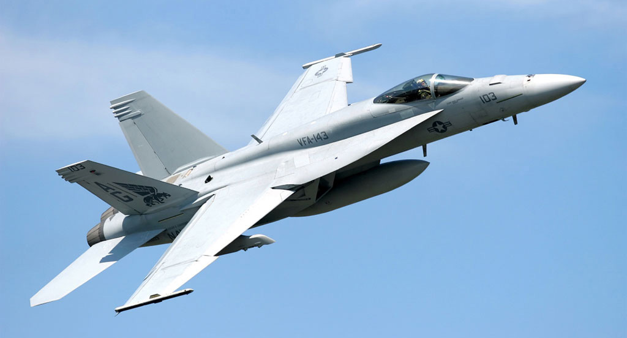
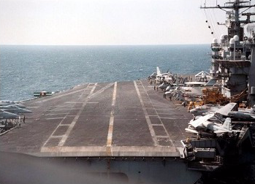
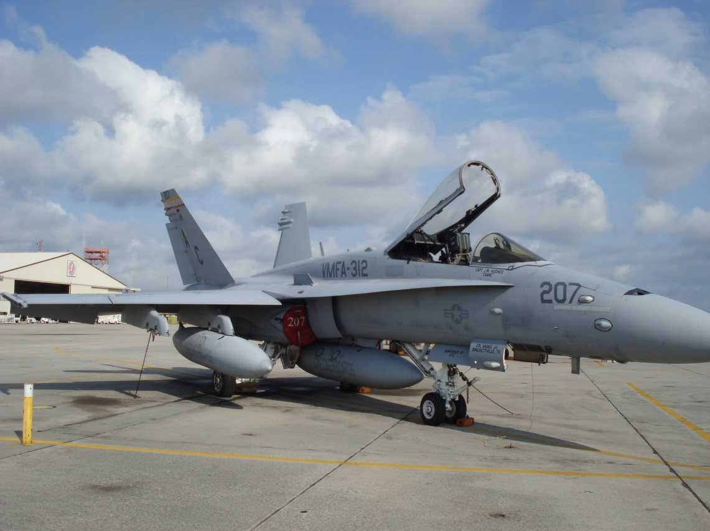
Our Goal is Love
“Begin with the end in mind” - Stephen R. Covey

Slide 10
Our Goal is Love
(1Tim 1:5) “Aim of our charge”
1Tim 1:5 (NASB)
5 But the goal [aim of our charge, ESV] of our instruction is love from a pure heart and a good conscience and a sincere faith.

Slide 11
Our Goal is Love
(1Tim 1:5) “Aim of our charge”
(Gal 5:6) Faith must work through love
Gal 5:6 (NASB)
6 For in Christ Jesus neither circumcision nor uncircumcision means anything, but faith working through love.

Slide 12
Our Goal is Love
(1Tim 1:5) “Aim of our charge”
(Gal 5:6) Faith must work through love
(2Pet 1:5-7) Love is the goal
2Pet 1:5-7 (NKJV)
5 But also for this very reason, giving all diligence, add to your faith virtue, to virtue knowledge, 6 to knowledge self-control, to self-control perseverance, to perseverance godliness,7 to godliness brotherly kindness, and to brotherly kindness love.

Slide 13
Our Goal is Love
1Jn 4:7-8, 16-17 (NASB)
7 Beloved, let us love one another, for love is from God; and everyone who loves is born of God and knows God. 8 The one who does not love does not know God, for God is love.
16 We have come to know and have believed the love which God has for us. God is love, and the one who abides in love abides in God, and God abides in him. 17 By this, love is perfected with us, so that we may have confidence in the day of judgment; because as He is, so also are we in this world.
(1Tim 1:5) “Aim of our charge”
(Gal 5:6) Faith must work through love
(2Pet 1:5-7) Love is the goal
(1Jn 4:7-8, 16-17)
God is love
Required for salvation?
No love, no God
Having love gives us confidence in the day of judgement
L0ve
L0ve

Slide 14
Our Goal is Love
(1Tim 1:5) “Aim of our charge”
(Gal 5:6) Faith must work through love
(2Pet 1:5-7) Love is the goal
(1Jn 4:7-8, 16-17)
God is love
Required for salvation?
No love, no God
Having love gives us confidence in the day of judgement
(2Jn 6) Walk according to his commandments
2Jn 6 (NIV)
6 And this is love: that we walk in obedience to his commands. As you have heard from the beginning, his command is that you walk in love.
L0ve
L0ve

Slide 15
Our Goal is Love
(1Tim 1:5) “Aim of our charge”
(Gal 5:6) Faith must work through love
(2Pet 1:5-7) Love is the goal
(1Jn 4:7-8, 16-17)
God is love
Required for salvation?
No love, no God
Having love gives us confidence in the day of judgement
(2Jn 6) Walk according to his commandments
(1Cor 13:1) Works without love = worthless
1Cor 13:1 (NIV)
13:1 If I speak in the tongues of men or of angels, but do not have love, I am only a resounding gong or a clanging cymbal.
L0ve
L0ve

Slide 16
Focus on Love
Hear (Rom 10:17)
Believe (John 3:16, Gal 5:6)
Repent (Acts 2:38)
Confess (Mt 10:32)
Baptized (Mk 16:16)
Obey (Jn 14:15, 2Jn 6, Mt 10:22, Rev 10:7)
Notes:
Hear how much God loves us, and the person that preached the good news to us loved us.
Believe: (Gal 5:6) Faith working through love
Repent: To love God is to hate sin (Ps 97:10, Let those who love the Lord hate evil...)
Confess: We must be willing to confess Christ as our savior and that we love him for that sacrifice.
Baptism: How we make the connection – start that relationship – with Christ, because now we’re no longer separated from Him by sin.
Obey: (Jn 14:15, “If you love me, keep my commandments”; 2Jn 6, “And this is love: that we walk in obedience to his commands.”; Mt 10:22, “the one who stands firm to the end will be saved.”)

Slide 17
Are You Ready? Love is the Key

