Slide 1
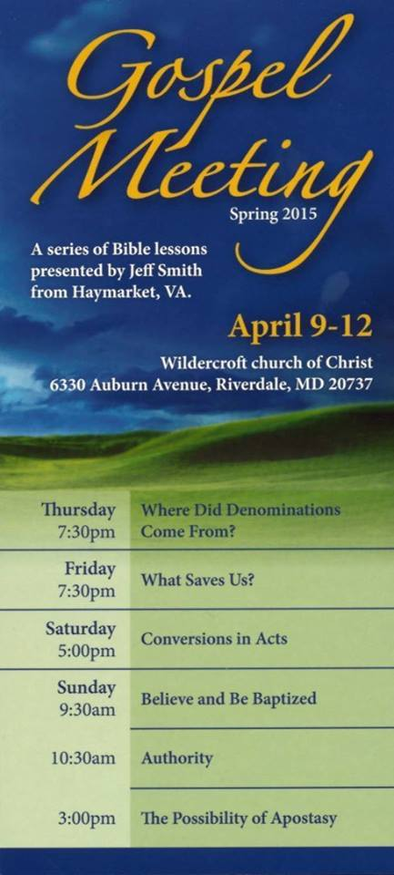

Slide 2
What Saves Us?
What the Bible Says About
Salvation

Slide 3
One issue that divides denominations:
What Saves Us?
God? Faith? Works? Baptism? Ourselves?

Slide 4
The Episcopalians Line Up with the Roman Catholics and Many Others on this Issue
“We are accounted righteous before God, only for the merit of our Lord and Saviour Jesus Christ by Faith, and not for our own works or deservings. Wherefore, that we are justified by Faith only, is a most wholesome Doctrine, and very full of comfort, as more largely expressed in the Homily of Justification.”
Article XI
Articles of Religion
The Book of Common Prayer
1979 Edition, page 870
Notes:
I mentioned my 5 years as an Episcopalian.

Slide 5
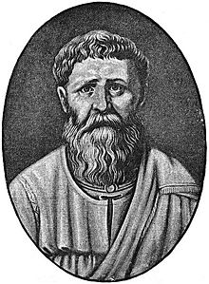
1 AD
1000
2000
This is an old, often debated, question.
Augustine of Hippo
Augustine taught that some people are predestined by God to salvation by an eternal, sovereign decree which is not based on man's merit or will. The saving grace which God bestows is irresistible and unfailingly results in conversion.
Notes:
354-430 AD wrote Confessions and City of God. His thoughts profoundly influenced the medieval worldview.

Slide 6
1 AD
1000
2000
God Saves Us We Save Ourselves
Augustine of Hippo
Pelagius
Pelagius denied Augustine's theory of original sin. His adherents cited Deuteronomy 24:16 in support of their position. Pelagius was declared a heretic by the Council of Carthage. His interpretation of a doctrine of free will became known as Pelagianism.
Notes:
Battle lines were drawn in the 4th century AD.

Slide 7
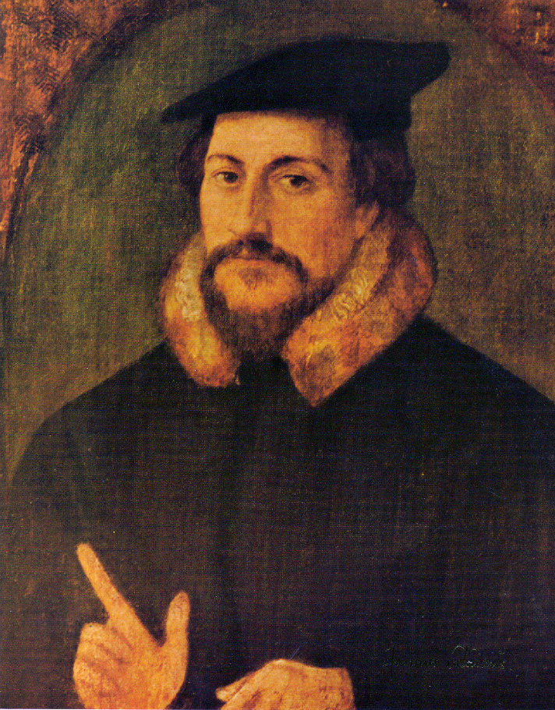
1 AD
1000
2000
God Saves Us We Save Ourselves
John Calvin
Calvin was influenced by the Augustinian tradition, which led him to expound the doctrine of predestination and the absolute sovereignty of God in salvation of the human soul from death and eternal damnation.
Notes:
Debate continued in the 17th century AD.

Slide 8
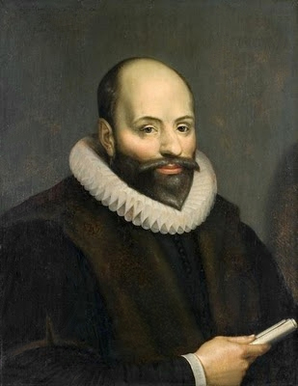
1 AD
1000
2000
God Saves Us We Save Ourselves
John Calvin
Jacobus Arminius
The offer of salvation through grace does not act irresistibly in a purely cause-effect, deterministic method but rather in an influence-and-response fashion that can be both freely accepted and freely denied.
Notes:
These two took up the debate around 1600.

Slide 9
1 AD
1000
2000
God Saves Us We Save Ourselves
It is possible to find verses that support each side.
Sometimes right together.
(12) But as many as received Him, to them He gave the right to become children of God, even to those who believe in His name, (13) who were born, not of blood nor of the will of the flesh nor of the will of man, but of God. (John 1:12-13)

Slide 10
God Saves Us We Save Ourselves
It is possible to find verses that support each side.
Sometimes right together.
(44) "No one can come to Me unless the Father who sent Me draws him; and I will raise him up on the last day. (45) "It is written in the prophets, 'AND THEY SHALL ALL BE TAUGHT OF GOD.' Everyone who has heard and learned from the Father, comes to Me. (John 6:44-45)

Slide 11
What Saves?
Search the Scriptures for References to
Saved by
Justified by
Saves Us
Whoever speaks, is to do so as one who is speaking the utterances of God; whoever serves is to do so as one who is serving by the strength which God supplies; so that in all things God may be glorified through Jesus Christ, to whom belongs the glory and dominion forever and ever. Amen. (1 Peter 4:11)

Slide 12
What Saves?
God the Father
Jesus (Life, Blood)
Holy Spirit
Spouse
Preacher
Ourselves
Gospel (Words)
Grace
Preaching
Love of Truth
Faith (Belief)
Confession
Works
Baptism (Water)
Therefore do not be ashamed of the testimony of our Lord or of me His prisoner, but join with me in suffering for the gospel according to the power of God, who has saved us and called us with a holy calling, not according to our works, but according to His own purpose and grace which was granted us in Christ Jesus from all eternity, (2 Timothy 1:8-9)
Notes:
Verses on left-bottom. Running list on right.

Slide 13
What Saves?
God the Father
Jesus (Life, Blood)
Holy Spirit
Spouse
Preacher
Ourselves
Gospel (Words)
Grace
Preaching
Love of Truth
Faith (Belief)
Confession
Works
Baptism (Water)
But when he had considered this, behold, an angel of the Lord appeared to him in a dream, saying, "Joseph, son of David, do not be afraid to take Mary as your wife; for the Child who has been conceived in her is of the Holy Spirit. "She will bear a Son; and you shall call His name Jesus, for He will save His people from their sins." (Matthew 1:20-21)

Slide 14
What Saves?
God the Father
Jesus (Life, Blood)
Holy Spirit
Spouse
Preacher
Ourselves
Gospel (Words)
Grace
Preaching
Love of Truth
Faith (Belief)
Confession
Works
Baptism (Water)
Much more then, having now been justified by His blood, we shall be saved from the wrath of God through Him. For if while we were enemies we were reconciled to God through the death of His Son, much more, having been reconciled, we shall be saved by His life. (Romans 5:9-10)

Slide 15
What Saves?
God the Father
Jesus (Life, Blood)
Holy Spirit
Spouse
Preacher
Ourselves
Gospel (Words)
Grace
Preaching
Love of Truth
Faith (Belief)
Confession
Works
Baptism (Water)
But when the kindness of God our Savior and His love for mankind appeared, He saved us, not on the basis of deeds which we have done in righteousness, but according to His mercy, by the washing of regeneration and renewing by the Holy Spirit,
(Titus 3:4-5)

Slide 16
What Saves?
God the Father
Jesus (Life, Blood)
Holy Spirit
Spouse
Preacher
Ourselves
Gospel (Words)
Grace
Preaching
Love of Truth
Faith (Belief)
Confession
Works
Baptism (Water)
For how do you know, O wife, whether you will save your husband? Or how do you know, O husband, whether you will save your wife?
(1 Corinthians 7:16)

Slide 17
What Saves?
God the Father
Jesus (Life, Blood)
Holy Spirit
Spouse
Preacher
Ourselves
Gospel (Words)
Grace
Preaching
Love of Truth
Faith (Belief)
Confession
Works
Baptism (Water)
To the weak I became weak, that I might win the weak; I have become all things to all men, so that I may by all means save some.
(1 Corinthians 9:22)

Slide 18
What Saves?
God the Father
Jesus (Life, Blood)
Holy Spirit
Spouse
Preacher
Ourselves
Gospel (Words)
Grace
Preaching
Love of Truth
Faith (Belief)
Confession
Works
Baptism (Water)
And with many other words he testified, and exhorted them, saying, Save yourselves from this crooked generation.
(Acts 2:40)

Slide 19
What Saves?
God the Father
Jesus (Life, Blood)
Holy Spirit
Spouse
Preacher
Ourselves
Gospel (Words)
Grace
Preaching
Love of Truth
Faith (Belief)
Confession
Works
Baptism (Water)
Now I make known to you, brethren, the gospel which I preached to you, which also you received, in which also you stand, by which also you are saved, if you hold fast the word which I preached to you, unless you believed in vain.
(1 Corinthians 15:1-2)

Slide 20
What Saves?
God the Father
Jesus (Life, Blood)
Holy Spirit
Spouse
Preacher
Ourselves
Gospel (Words)
Grace
Preaching
Love of Truth
Faith (Belief)
Confession
Works
Baptism (Water)
But God, being rich in mercy, because of His great love with which He loved us, even when we were dead in our transgressions, made us alive together with Christ (by grace you have been saved),
(Ephesians 2:4-5)

Slide 21
What Saves?
God the Father
Jesus (Life, Blood)
Holy Spirit
Spouse
Preacher
Ourselves
Gospel (Words)
Grace
Preaching
Love of Truth
Faith (Belief)
Confession
Works
Baptism (Water)
For since in the wisdom of God the world through its wisdom did not come to know God, God was well-pleased through the foolishness of the message preached to save those who believe.
(1 Corinthians 1:21)

Slide 22
What Saves?
God the Father
Jesus (Life, Blood)
Holy Spirit
Spouse
Preacher
Ourselves
Gospel (Words)
Grace
Preaching
Love of Truth
Faith (Belief)
Confession
Works
Baptism (Water)
and with all the deception of wickedness for those who perish, because they did not receive the love of the truth so as to be saved.
(2 Thessalonians 2:10)

Slide 23
What Saves?
God the Father
Jesus (Life, Blood)
Holy Spirit
Spouse
Preacher
Ourselves
Gospel (Words)
Grace
Preaching
Love of Truth
Faith (Belief)
Confession
Works
Baptism (Water)
Therefore, having been justified by faith, we have peace with God through our Lord Jesus Christ, through whom also we have obtained our introduction by faith into this grace in which we stand; and we exult in hope of the glory of God.
(Romans 5:1-2)

Slide 24
What Saves?
God the Father
Jesus (Life, Blood)
Holy Spirit
Spouse
Preacher
Ourselves
Gospel (Words)
Grace
Preaching
Love of Truth
Faith (Belief)
Confession
Works
Baptism (Water)
that if you confess with your mouth Jesus as Lord, and believe in your heart that God raised Him from the dead, you will be saved; for with the heart a person believes, resulting in righteousness, and with the mouth he confesses, resulting in salvation.
(Romans 10:9-10)

Slide 25
What Saves?
God the Father
Jesus (Life, Blood)
Holy Spirit
Spouse
Preacher
Ourselves
Gospel (Words)
Grace
Preaching
Love of Truth
Faith (Belief)
Confession
Works
Baptism (Water)
You see that a man is justified by works and not by faith alone.
(James 2:24)

Slide 26
What Saves?
God the Father
Jesus (Life, Blood)
Holy Spirit
Spouse
Preacher
Ourselves
Gospel (Words)
Grace
Preaching
Love of Truth
Faith (Belief)
Confession
Works
Baptism (Water)
who once were disobedient, when the patience of God kept waiting in the days of Noah, during the construction of the ark, in which a few, that is, eight persons, were brought safely through the water. Corresponding to that, baptism now saves you--not the removal of dirt from the flesh, but an appeal to God for a good conscience--through the resurrection of Jesus Christ, (1 Peter 3:20-21)

Slide 27
What Saves?
God the Father
Jesus (Life, Blood)
Holy Spirit
Spouse
Preacher
Ourselves
Gospel (Words)
Grace
Preaching
Love of Truth
Faith (Belief)
Confession
Works
Baptism (Water)
The Bible says at least 14 things save us.
How can some say only 1 thing saves us?

Slide 28
What Saves?
God the Father
Jesus (Life, Blood)
Holy Spirit
Spouse
Preacher
Ourselves
Gospel (Words)
Grace
Preaching
Love of Truth
Faith (Belief)
Confession
Works
Baptism (Water)
Can we make more sense of this?

Slide 29
What Saves?
God the Father
Jesus (Life, Blood)
Holy Spirit
Spouse
Preacher
Ourselves
Gospel (Words)
Grace
Preaching
Love of Truth
Faith (Belief)
Confession
Works
Baptism (Water)
Agent
One who acts or exerts power

Slide 30
What Saves?
God the Father
Jesus (Life, Blood)
Holy Spirit
Spouse
Preacher
Ourselves
Gospel (Words)
Grace
Preaching
Love of Truth
Faith (Belief)
Confession
Works
Baptism (Water)
Agent
One who acts or exerts power
Means
Methods and resources for accomplishing something

Slide 31
What Saves?
God the Father
Jesus (Life, Blood)
Holy Spirit
Spouse
Preacher
Ourselves
Gospel (Words)
Grace
Preaching
Love of Truth
Faith (Belief)
Confession
Works
Baptism (Water)
Agent
One who acts or exerts power
Means
Methods and resources for accomplishing something
Conditions
A premise upon which the fulfillment of an agreement depends

Slide 32
God Saves Us We Save Ourselves
It is possible to find verses that support each side.
Sometimes right together.

Slide 33
God Saves Us We Save Ourselves
It is possible to find verses that support each side.
Sometimes right together.
Because Both Are True

Slide 34
What Saves?
God the Father
Jesus (Life, Blood)
Holy Spirit
Spouse
Preacher
Ourselves
Gospel (Words)
Grace
Preaching
Love of Truth
Faith (Belief)
Confession
Works
Baptism (Water)
But as many as received Him, to them He gave the right to become children of God, even to those who believe in His name, (13) who were born, not of blood nor of the will of the flesh nor of the will of man, but of God.
(John 1:12-13)

Slide 35
What Saves?
God the Father
Jesus (Life, Blood)
Holy Spirit
Spouse
Preacher
Ourselves
Gospel (Words)
Grace
Preaching
Love of Truth
Faith (Belief)
Confession
Works
Baptism (Water)
But as many as received Him, to them He gave the right to become children of God, even to those who believe in His name, (13) who were born, not of blood nor of the will of the flesh nor of the will of man, but of God.
(John 1:12-13)

Slide 36
What Saves?
God the Father
Jesus (Life, Blood)
Holy Spirit
Spouse
Preacher
Ourselves
Gospel (Words)
Grace
Preaching
Love of Truth
Faith (Belief)
Confession
Works
Baptism (Water)
But as many as received Him, to them He gave the right to become children of God, even to those who believe in His name, (13) who were born, not of blood nor of the will of the flesh nor of the will of man, but of God.
(John 1:12-13)

Slide 37
What Saves?
God the Father
Jesus (Life, Blood)
Holy Spirit
Spouse
Preacher
Ourselves
Gospel (Words)
Grace
Preaching
Love of Truth
Faith (Belief)
Confession
Works
Baptism (Water)
"No one can come to Me unless the Father who sent Me draws him; and I will raise him up on the last day. (45) "It is written in the prophets, 'AND THEY SHALL ALL BE TAUGHT OF GOD.' Everyone who has heard and learned from the Father, comes to Me.
(John 6:44-45)

Slide 38
What Saves?
God the Father
Jesus (Life, Blood)
Holy Spirit
Spouse
Preacher
Ourselves
Gospel (Words)
Grace
Preaching
Love of Truth
Faith (Belief)
Confession
Works
Baptism (Water)
"No one can come to Me unless the Father who sent Me draws him; and I will raise him up on the last day. (45) "It is written in the prophets, 'AND THEY SHALL ALL BE TAUGHT OF GOD.' Everyone who has heard and learned from the Father, comes to Me.
(John 6:44-45)

Slide 39
What Saves?
God the Father
Jesus (Life, Blood)
Holy Spirit
Spouse
Preacher
Ourselves
Gospel (Words)
Grace
Preaching
Love of Truth
Faith (Belief)
Confession
Works
Baptism (Water)
"No one can come to Me unless the Father who sent Me draws him; and I will raise him up on the last day. (45) "It is written in the prophets, 'AND THEY SHALL ALL BE TAUGHT OF GOD.' Everyone who has heard and learned from the Father, comes to Me.
(John 6:44-45)

Slide 40
What Saves?
What the Bible Says About
Salvation
Notes:
God has done and is doing His part to save you. Have you done, are you doing your part? There is yet time while there is life and breath.

