Slide 1
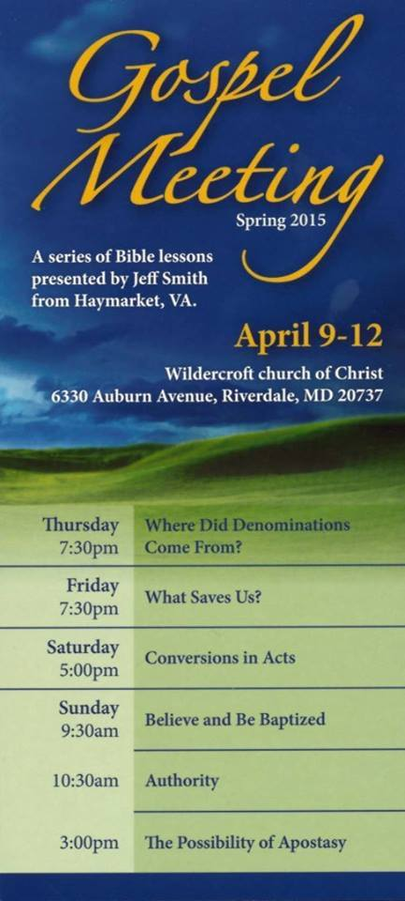

Slide 2
"I do not ask on behalf of these alone, but for those also who believe in Me through their word; that they may all be one; even as You, Father, are in Me and I in You, that they also may be in Us, so that the world may believe that You sent Me.
(John 17:20-21)

Slide 3
Where Did
Denominations
Come From?

Slide 4
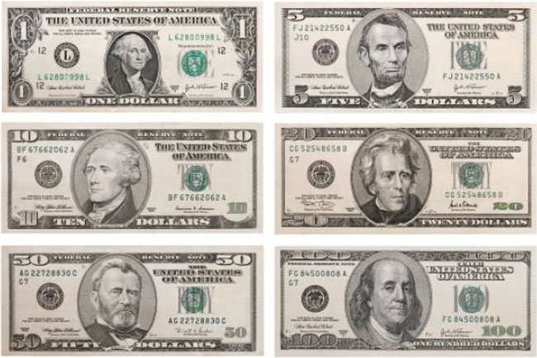
Denominations = Types

Slide 5
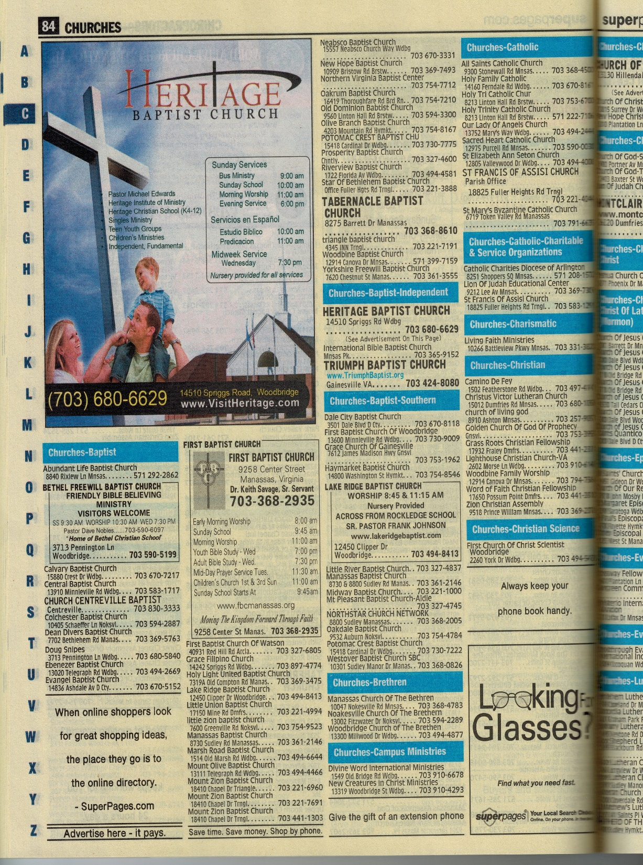
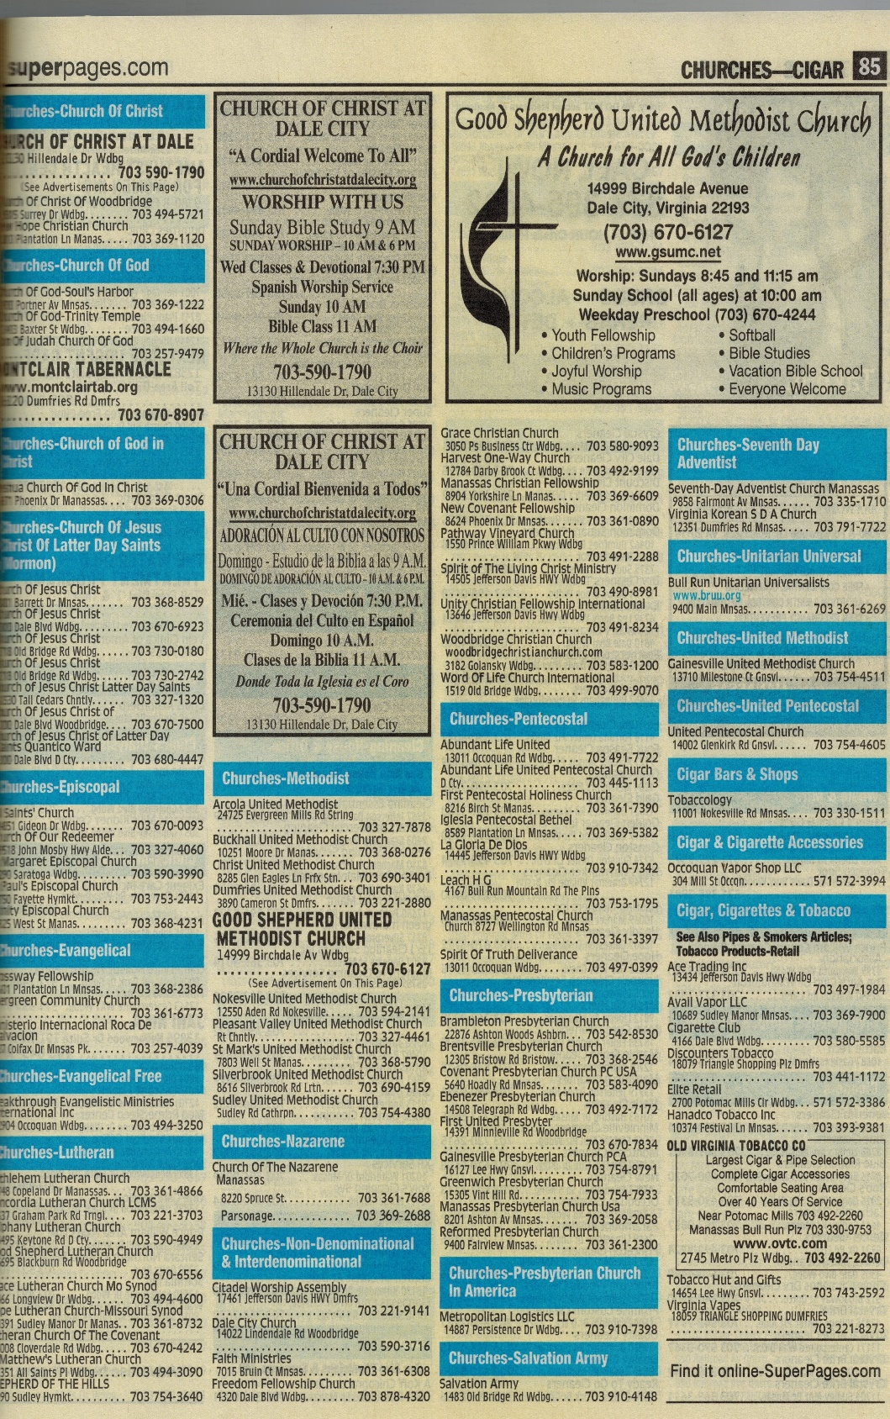

Slide 6
Where Did
Denominations
Come From?

Slide 7
Church History
From Birth
30 A.D.
To Present
2015 A.D.
Notes:
The goal of the presentation is to survey the development and apostasy of the church through the last two millennia.

Slide 8
AD 30 1000 2000
Notes:
Note the timeline across the top. Red bar indicates the region we are discussing.

Slide 9
The Church Is Born
AD 30 1000 2000
Acts 2:14
But Peter, standing up with the eleven, lifted up his voice, and said unto them, Ye men of Judaea, and all ye that dwell at Jerusalem, be this known unto you, and hearken to my words:
Notes:
In Biblical chronology the church is a relatively new entity. Christ preached of its conception (Matthew 16:18). Its birth is recorded in Acts 2, where Peter preached the first complete gospel sermon.

Slide 10
The Church Is Born
AD 30 1000 2000
Church
Acts 2:47
Praising God, and having favour with all the people. And the Lord added to the church daily such as should be saved.
Saved Souls
Notes:
Acts 2:47 records saved souls were added by the Lord to the church. The church didn’t save. The saved were added to the church. And how they would be saved was prescribed (more on that on Saturday).

Slide 11
Hallmarks of Church
AD 30 1000 2000
Distinctive
Practices
Organization
Authorized in Bible
Notes:
The Bible records several distinctive hallmarks of the first century church.
It was distinct in both practice and organization.

Slide 12
Hallmarks of Church
AD 30 1000 2000
Worship
Assembled
Lord’s Supper
Taught
Acts 20:7 And upon the first day of the week, when the disciples came together to break bread, Paul preached unto them, ready to depart on the morrow; and continued his speech until midnight.
Notes:
First consider the distinctive practices of the church.
Acts 20:7 reveals much about the New Testament church. They assembled on the first day of the week, they partook of the Lord’s Supper, and there was preaching or teaching.

Slide 13
Hallmarks of Church
AD 30 1000 2000
Worship
Assembled
Lord’s Supper
Taught
Sang
Prayed
1 Corinthians 14:15 What is it then? I will pray with the spirit, and I will pray with the understanding also: I will sing with the spirit, and I will sing with the understanding also.
Notes:
1 Corinthians 14:15 tells us that the church sang and prayed.

Slide 14
Hallmarks of Church
AD 30 1000 2000
Worship
Assembled
Lord’s Supper
Taught
Sang
Prayed
Gave
1 Corinthians 16:2 Upon the first day of the week let every one of you lay by him in store, as God hath prospered him,
Notes:
1 Corinthians 16:2 tells us that churches were to lay by in store on the first day of the week.

Slide 15
AD 30 1000 2000
Hallmarks of Church
Organization
Elders
Deacons
Saints
Philippians 1:1 Paul and Timotheus, the servants of Jesus Christ, to all the saints in Christ Jesus which are at Philippi, with the bishops and deacons:
Notes:
The organization the New Testament church is also described in the scriptures.
Philippians 1:1 shows Paul sorted the members into three categories: elders or bishops, deacons, and saints.

Slide 16
AD 30 1000 2000
Hallmarks of Church
Organization
Elders
Feed Flock
Among Them
Plurality
Not Lords
1 Peter 5:2-3 Feed the flock of God which is among you, taking the oversight thereof, not by constraint, but willingly; not for filthy lucre, but of a ready mind; Neither as being lords over God's heritage, but being ensamples to the flock.
Notes:
1 Peter 5:2-3 chows that the elders were to feed the flock, take oversight of the church in their area. We can also infer that elders served in groups of two or more. Their attitude was to lead willing followers, not to constrain or Lord it over the flock.

Slide 17
AD 30 1000 2000
Hallmarks of Church
1 Timothy 3:13 For they that have used the office of a deacon well purchase to themselves a good degree, and great boldness in the faith which is in Christ Jesus.
Organization
Elders
Deacons
Office
Servants
Notes:
Deacons are special servants of the church. 1 Timothy 3:13 refers to the office of deacon. They, like elders, had special duties.

Slide 18
AD 30 1000 2000
Hallmarks of Church
Organization
Elders
Deacons
Saints
All Believers
Every Church
Colossians 1:2 To the saints and faithful brethren in Christ which are at Colosse: Grace be unto you, and peace, from God our Father and the Lord Jesus Christ.
Notes:
All the rest of the members were called saints. (Of course elders and deacons are saints, as well.) The term saint is now commonly associated with a very different idea than the scriptures reveal. In Bible times every member was called a saint.

Slide 19
The Church Changes
AD 30 1000 2000
Apostasy
Falling Away
Begun
To Be Resisted
Jude 3 … it was needful for me to write unto you, and exhort you that ye should earnestly contend for the faith which was once delivered unto the saints.
Notes:
Apostasy mean to fall away. We can infer from Jude 3 that in his time the falling away had already begun. If not contending for the faith would not be necessary. Jude also tells us of the permanence of the faith. It was once (some versious add “for all”) delivered to the saints.

Slide 20
AD 30 1000 2000
Christ’s Church
Appropriate Growth
Christ’s Church
Man’s Church
Mutation
Notes:
Christ planned for His church to change in size, i.e. grow. No where does He indicate that its practices would evolve or mutate. However, as we trace history we see that man acted upon the church to cause it to mutate into something altogether different from Christ’s plan.
These changes happened very gradually. Most people would hardly have noticed the changes as they were occurring.

Slide 21
The Church Changes
AD 30 1000 2000
Eldership
Presiding Elder
Elders
Notes:
One of the mutations involve church organization, specifically the eldership. As elders met they gradually adopted the practice of having one elder preside over the rest. Naturally this elder began to have more influence or power than the others.

Slide 22
The Church Changes
AD 30 1000 2000
Presiding Bishops Called Father, (Papa)
Eldership
Notes:
The presiding elders then began meeting to discuss and decide religious issues. Presiding elders from larger congregations had more influence in these meetings. Individuals began to exert great influence over large regions, a great change from the Lord’s will as revealed in 1 Peter 5:2-3.
These presiding elders were titled Papa, translated Pope.

Slide 23
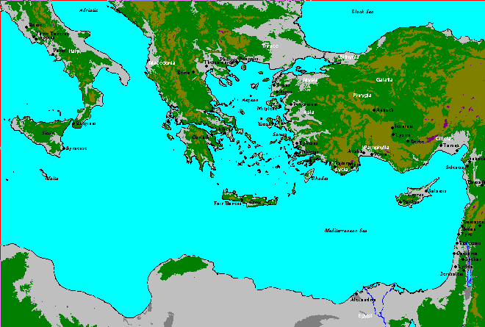
AD 30 1000 2000
Presiding Bishops (Popes) vie for Supremacy
Rome
Constantinople
Antioch
Jerusalem
Alexandria
Notes:
In the fifth and sixth centuries five presiding elders were prominent. These were in the cities listed above.

Slide 24
AD 30 1000 2000
Rome Won
Gregory thereupon secured from Emperor Phocas a decree acknowledging that "the See of Blessed Peter the Apostle should be the head of all the Churches" and that the title of "Universal Bishop" should be reserved exclusively for the bishop of Rome.
Notes:
Thereby Rome secured its place of religious supremacy. No pope from any other city would effectively challenge Rome position for hundreds of years.

Slide 25
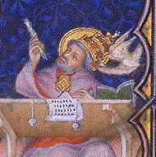
Pope Gregory I
AD 30 1000 2000
540 to 604 A.D.
Roman Pope
"I, albeit unworthy, have been set up in command of the Church."
Notes:
Eventually Pope Gregory the first presiding elder to have the title universal pope conferred upon him. Interestingly enough this pronouncement was made by a political entity (Phocas, Ruler of Constantinople), not a religious entity.

Slide 26
AD 30 1000 2000
Roman Catholic Church
Claims Apostolic Authority Over All Believers, RC Church Authorizes Changes to Name, Work, Worship of the Church
Notes:
Although this group called themselves the Roman Catholic or Universal Church, this organization has little in common with the church of the Bible. God had authorized none of these changes.
We use the term “church” accomodatively when referring to the various denominations.
The Roman church assumed that it had authority to make further changes to the organization and practices of the church. As a result of this fallacy, they continued on a slippery slope further and further away from the Lord.

Slide 27
The Church Changes
AD 30 1000 2000
Work & Worship
Holy Water
Penance
Latin Mass
Images of Saints
Extreme Unction
Purgatory
Notes:
Through the years the Roman Catholic (RC) Church adopted many practices foreign to the scriptures.
Holy water was water blessed by the priests.
Penance is the practice of working out restitution for sin.
The worship was called “mass” and was recited in Latin, not the language of the people.
Images of saints were used.
Extreme unction is often called the “last rites.” The idea is that if a dying person confessed to a priest the priest could forgive all the sins of their lifetime.
Purgatory was thought to be a place where dying souls could spend some time suffering yet subsequently go on to paradise.

Slide 28
The Church Changes
AD 30 1000 2000
Work & Worship
Celibacy
Instrumental Music
Transubstantiation
Indulgences
Auricular Confession
Sprinkling for Baptism
Notes:
They decided that their “priests” should not marry. Instrumental music was introduced.
Transubstantiation is the notion that somewhere in the mass the bread and wine actually become the body and blood of the Lord, even though they undergo no outward change.
Priests began to hear particularly offensive confessions in private, and soon took all confessions in private.
Sprinkling was initially used to baptize a very ill person who could not be immersed. Eventually it was accepted in any case.

Slide 29
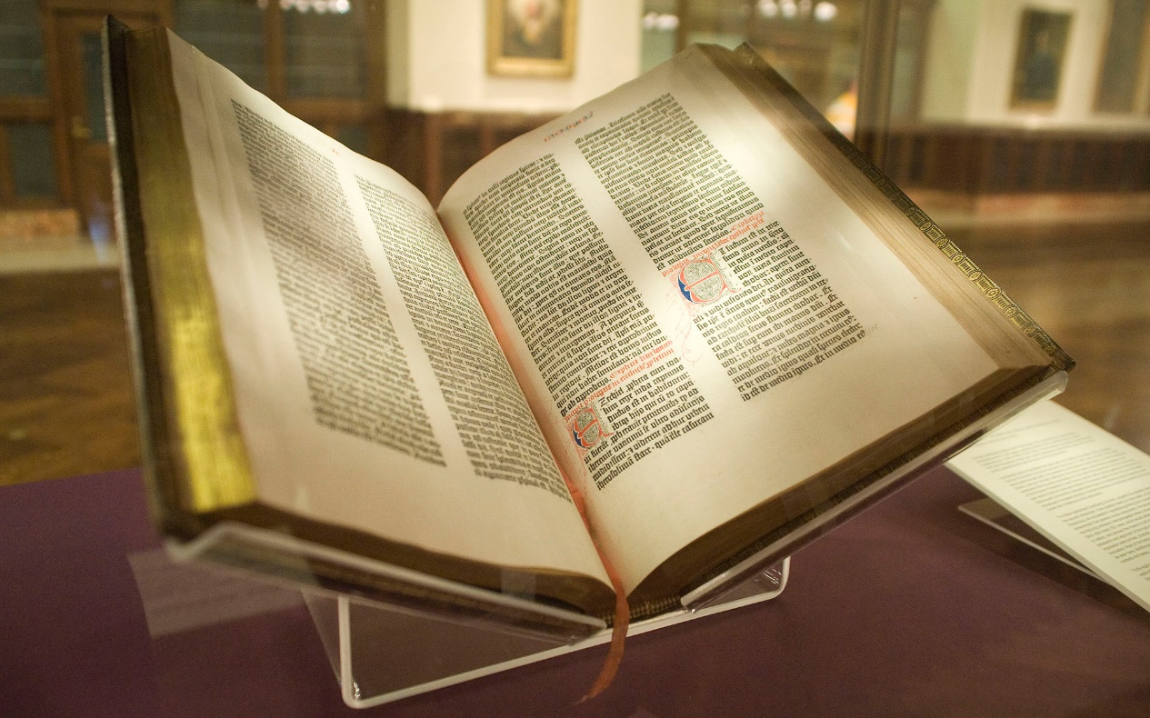
Church Reform
AD 30 1000 2000
Resistance to RC Church
Increases Through Dark/Middle Ages
Gutenberg Press Makes Bibles Available (1450’s AD)
Notes:
Through the 12th through the 15th centuries many small groups objected to the organization and practices of the RC church. These were quelled through reason, persecution, political pressure, and/or physical force. No one during these times was able to overcome the supremacy of the church.

Slide 30
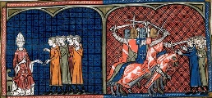
Church Reform
AD 30 1000 2000
Resistance to RC Church
Handled Through
Crusades
Spanish Inquisition
Notes:
Through the 12th through the 15th centuries many small groups objected to the organization and practices of the RC church. These were quelled through reason, persecution, political pressure, and/or physical force. No one during these times was able to overcome the supremacy of the church.

Slide 31
Church Reform
AD 30 1000 2000
Resistance to RC Church
By 1500, Resistance Is Significant
Many Points in Europe Give Rise to “Heresy”
Reform Is An Ideal Whose Time Has Come
Notes:
However, by the sixteenth century opposition had grown to where it no longer could be squelched.

Slide 32
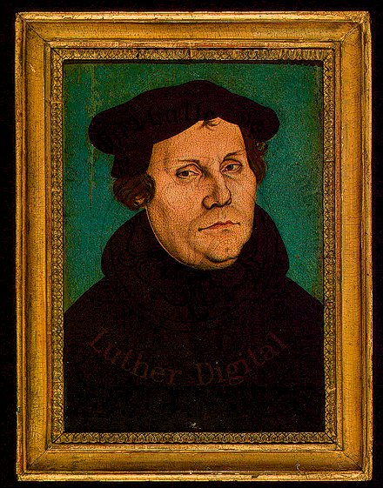
Church Reform (1517 to 1545)
AD 30 1000 2000
Martin Luther
Posts 95 Thesis on Door of Wittenberg, Germany, Castle Church, 1517
Lutherans
Notes:
Martin Luther of Germany is one of the most famous reformer of the RC church. Once a zealous monk, his scriptural objections to indulgences were posted on the door of the Wittenberg cathedral as debate proposals. They were dismissed as heresy and he was ultimately excommunicated from the RC church. His ideas were eventually adopted by the nobility, clergy, and citizens of northern Germany. Eventually this group became known as Lutherans.

Slide 33
Reformation
AD 30 1000 2000
Man’s Church
Mutation
Man’s Church
Mutation
Notes:
Through Luther’s efforts the church was brought closer to the Lord’s church. Yet Luther retained many of the RC errors.

Slide 34
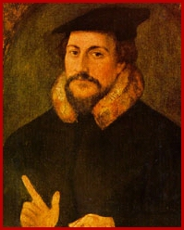
Church Reform (1517 to 1545)
AD 30 1000 2000
John Calvin
Promoted Reformation in Switzerland
Presbyterians
Notes:
John Calvin was another reformer. Originally from France he fled the country when attempts at reform were unsuccessful. He adopted Geneva, Switzerland, as his new home. Switzerland confederacy allowed each of its 13 cantons to decide their religion for themselves. Many adopted Calvin’s ideas. Thereby Presbyterianism became the second reform movement to be adopted by a nation.

Slide 35
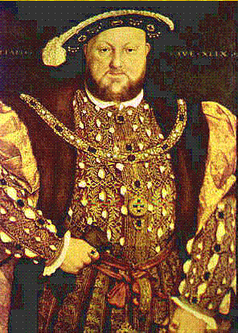
Church Reform (1517 to 1545)
AD 30 1000 2000
Henry VIII of England
King Is Head of Church in England, 1534
Church of England
Notes:
Henry VIII of England was a different kind of reformer. He ushered into England an entirely different kind of reform.
Reform in Germany had started with clerics and proceeded outward and upward as individuals were swayed. As the English Monarch Henry’s reform began with him and was legislated upon the people. His group became know as the church of England. It closely resembled Roman Catholicism in practice. The main difference was that instead of the Pope being in charge the English Monarch was head of the Church of England.

Slide 36
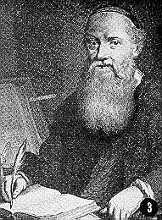
Church Reform (1517 to 1545)
AD 30 1000 2000
Menno Simons
Promoted Reform in Holland
Anabaptists
Mennonites
Notes:
The Anabaptists began in Switzerland. Among other reform ideas they encouraged converts to be immersed as adults to correct their sprinkling as babies. Unlike the Lutherans and Presbyterians no political powers adopted Anabaptism, and they became the outcasts of Europe. They also suffered from bizarre and incompetent leadership.
They fled to the Netherlands and eventually prospered under the leadership of Menno Simons. Eventually this group became known as Mennonites.

Slide 37
Church Reform (1517 to 1545)
AD 30 1000 2000
RC Church Fought Reform
Council of Trent, 1545 -1563 A.D.
Tradition is Binding
Seven Sacraments Reaffirmed
Transubstantiation Reaffirmed
Dogma Binding on All Faithful
Closing Door After Horse Is Gone
Notes:
In response to widespread loss of people, power, and influence, the RC church called the Council of Trent. This was a wonderful opportunity for them to right their various wrongs. Had they done so the mass exodus might have slowed.
Instead they hardened their stance. Many traditional practices heretofore unwritten were clearly set forth as dogma or doctrine. This served to fuel the reforming fires.

Slide 38
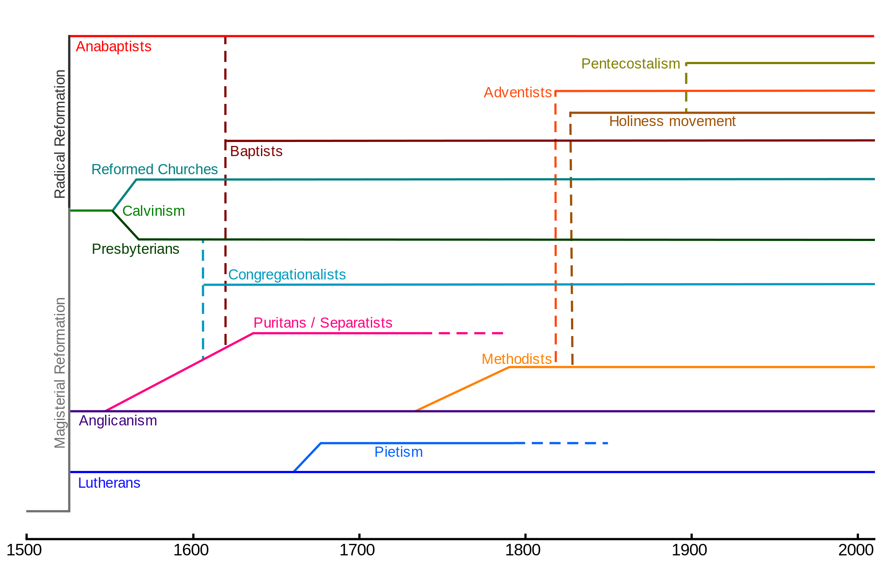

Slide 39
Reforming the Reformed
AD 30 1000 2000
Protestant Decay
Corruption Among Clergy
Reforms Were Incomplete
Reforms Had Not Gone Far Enough
Notes:
As the RC church had become corrupt so the reformed churches fell back.

Slide 40
Re-Reformation
AD 30 1000 2000
Man’s Church
Mutation
Man’s Church
Mutation
Notes:
Through the 17th, 18th, and 19th centuries reformed churches were reformed.
Through these successive reformations denominations were brought closer to the organization and practice of the New Testament church. However the pure New Testament pattern still eluded “Christianity.”

Slide 41
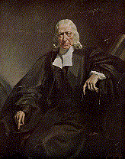
Reforming the Reformed
AD 30 1000 2000
Church of England
Puritans, Quakers, (1600’s)
Methodists (1700’s)
John Wesley
Notes:
In England John Wesley professed personal holiness to fight ignorance and apathy among the members and clergy of the Church of England. His group began within the church of England but eventually broke away completely. They were named for the methods they professed. Methodists were further subdivided into other denominations.

Slide 42
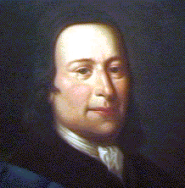
Reforming the Reformed
AD 30 1000 2000
Lutherans
Pietists (1600’s)
Moravians (1700’s)
Mennonites
Amish
Count Zinzendorf
Bishop of Moravian Church
Notes:
Similar reforms groups broke away from the Lutherans and Mennonites.
Count Zinzendorf encouraged Lutheran to be devoted to the Christ. His followers drew out of the Lutheran church. In 1742 the Moravian church was recognized as separate from Lutherans.

Slide 44
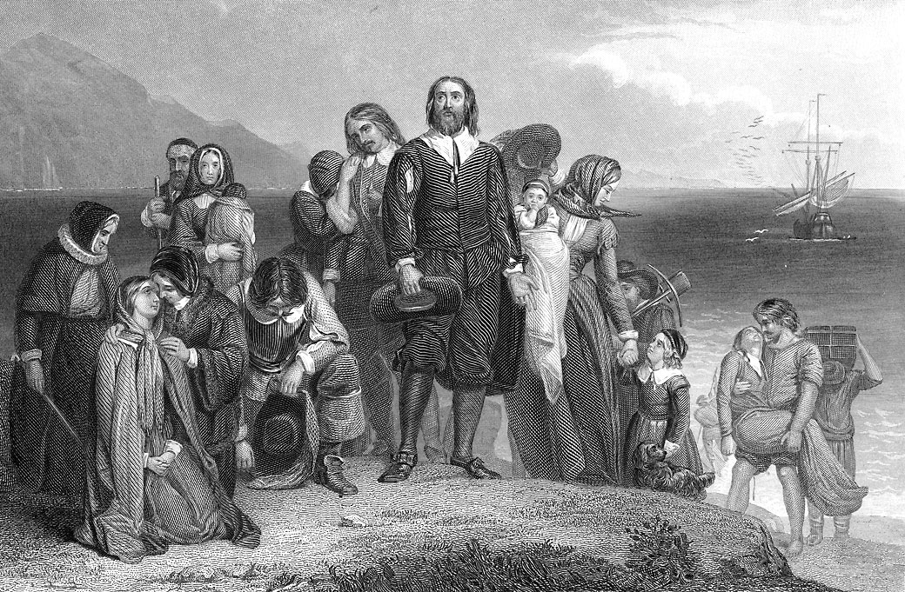
The Church in America
AD 30 1000 2000
Reformers Fled to America to Avoid Religious Persecution
Puritans
Moravians
Amish
Notes:
The Anabaptists still had no safe haven in Europe. Due to persecution they fled to America and established colonies there.

Slide 45
The Church in America
AD 30 1000 2000
Existing Denominations Evangelized America
Roman Catholicism
Church of England
Methodists
Presbyterians
Notes:
As nations sent emissaries to America so their formal religions were ushered into the colonies.

Slide 47
The Church in America
AD 30 1000 2000
Immigrants Brought Their Religions with Them
Reforming Renewed
Puritans Baptists
Methodist Church of God
Notes:
Eventually every flavor of Christianity in Europe found its way to America to some degree.
Re-reformed groups were reformed in America. Check any phone book to see the many various forms of Christianity extant in America today.

Slide 48
The Church in America
AD 30 1000 2000
Churches Combined
Organic Union
Northern Methodists
Methodists
(1939)
United Methodist Church
(1968)
Southern Methodists
Evangelical United Brethren
Notes:
Eventually so many varied group had to re-unite. And so it was. When various denominations agree to unite it is called organic union.
The Northern and Southern Methodists united in 1939 to form the Methodists, who later merged with the Evangelical United Brethren to form the United Methodist in 1968.

Slide 49
The Church in America
AD 30 1000 2000
Churches Cooperated
YMCA
American Bible Society
Christian Endeavor Society
Federal Council of Churches of Christ in America (33 groups)
Notes:
The various denominations began cooperating, in what is called ecumenism. Churches cooperated to provide recreation, spread the word, print the word, and generally confer.

Slide 50
Restoration in America
AD 30 1000 2000
Notes:
The restoration movement, attempts to restore the New Testament church not simply reform denominations, began independently in at least four distinct places in America in the early 1800’s.

Slide 51
Restoration in America
AD 30 1000 2000
Don’t Reform Man’s Church
Start All Over with Christ’s Church
Simultaneous, Uncoordinated Beginnings
Notes:
The restoration movement, attempts to restore the New Testament church not simply reform denominations, began independently in at least four distinct places in America in the early 1800’s.

Slide 52
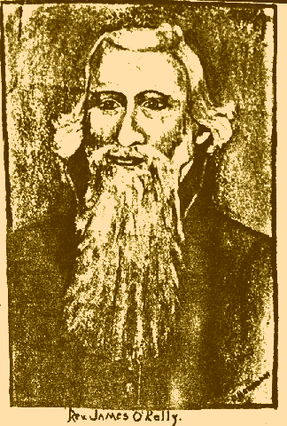
Restoration in America
AD 30 1000 2000
James O’Kelley
Surrey County, VA, 1794
Notes:
James O’Kelley was also active in Kentucky and North Carolina.

Slide 53
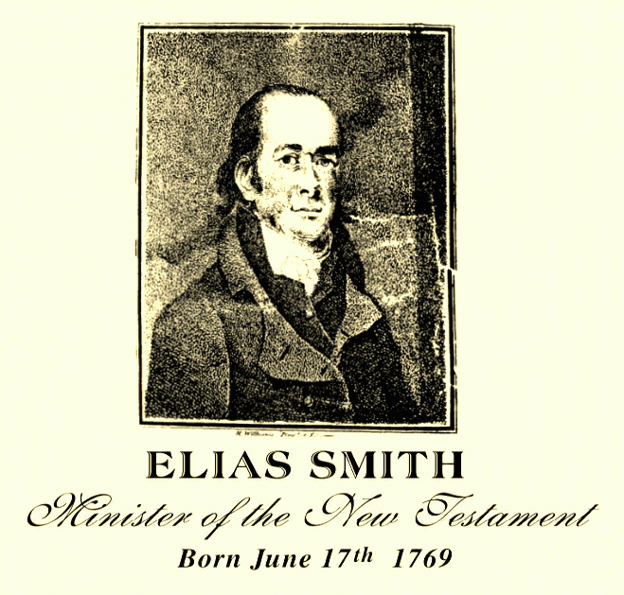
Restoration in America
AD 30 1000 2000
Elias Smith
Portsmouth, NH, 1802
Notes:
Elias Smith was active in Portsmouth, New Hampshire. Neither O’Kelley’s nor Smith’s work ever grew to movements of any substance.

Slide 54
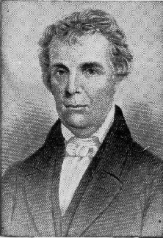
Restoration in America
AD 30 1000 2000
Barton W. Stone
Cane Ridge, KY, 1804
Notes:
However, Barton W. Stone and the Cane Ridge church ushered in a restoration movement in America. Personal study led Stone to oppose the Presbyterian church in America. He initially attempted to reform the Presbyterians, establishing the Springfield Presbytery. Within a year he dissolved that group with a famous document, The Last Will and Testament of the Springfield Presbytery. He urged that all such groups dissolve and become groups of Christians, using the Bible as their sole authority in religious matters.

Slide 55
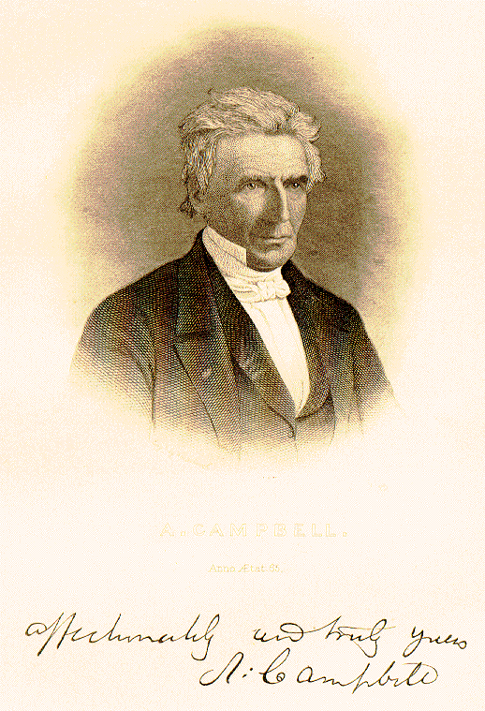
Restoration in America
AD 30 1000 2000
Alexander Campbell
Brush Run, PA, 1830
Notes:
Alexander Campbell built on the work of his father, Thomas, and ushered in reform throughout western Pennsylvania and the Ohio River Valley.

Slide 56
AD 30 1000 2000
Man’s Church
Mutation
Christ’s Church
Notes:
Finally, through their devotion to scriptures, to some small degree, churches of men were replaced by Christ’s church.

Slide 57
Restoration in America
AD 30 1000 2000
Bible as sufficient rule of faith and practice
Named Christians only
Opposed Human Creeds
Restoration of Ancient Order
Notes:
Again the Bible was the standard for practice and doctrine.

Slide 58
Restoration in America
AD 30 1000 2000
Churches
Local
Meets to Worship
Acts to Serve Christ
Universal
Does Not Meet
No Organization in Between
Notes:
Again the Bible was the standard for organization.

Slide 59
Hallmarks of Church
AD 30 1000 2000
Distinctive
Practices
Organization
Presented in Bible
Notes:
The church of the New Testament was restored.

Slide 60
Restoration in America
AD 30 1000 2000
Ongoing Division and Uniting
Missionary Societies
Instrumental Music
Social Gospel
Support of Institutions
Marriage, Divorce
Homosexual Marriage
Notes:
Restoration is never done, however. As will all predecessors these restored churches fought decay and error. Above are just a few of the issues that have divided the church in the past two centuries.

Slide 61
Church History
From Birth
30 A.D.
To Present
2015 A.D.
Notes:
The church has changed much in 2000 years. Let’s continue to restore God’s church.

Slide 62
"I do not ask on behalf of these alone, but for those also who believe in Me through their word; that they may all be one; even as You, Father, are in Me and I in You, that they also may be in Us, so that the world may believe that You sent Me.
(John 17:20-21)

